Slide 1
Product Locator
Lizzie Kim and Aman SINGH: Summer 2019

Slide 2
Problem:
Problem
Customers look for products and the locations carrying specific Maple Leaf Products, but there is no searchable database
There is a loss of potential purchases, impacting customer service and sales
Total availability concerns with respect to product from 2017-May 2019: 7467
Increase by 38% from 2017 to 2018, on track to continue increasing
Customers are calling in to look for products and the locations carrying specific Maple Leaf Products, but there is no search database that helps customer service find this easily

Slide 3
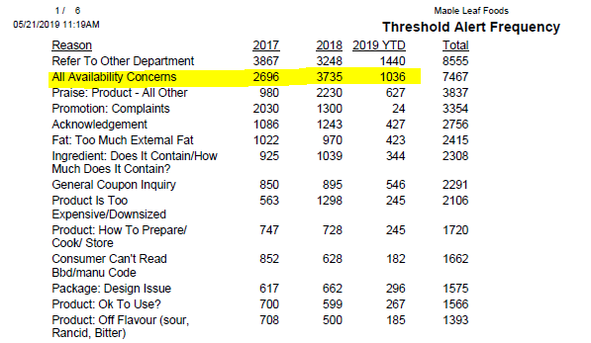
Problem:
Customers are calling in to look for products and the locations carrying specific Maple Leaf Products, but there is no search database that helps customer service find this easily

Slide 4
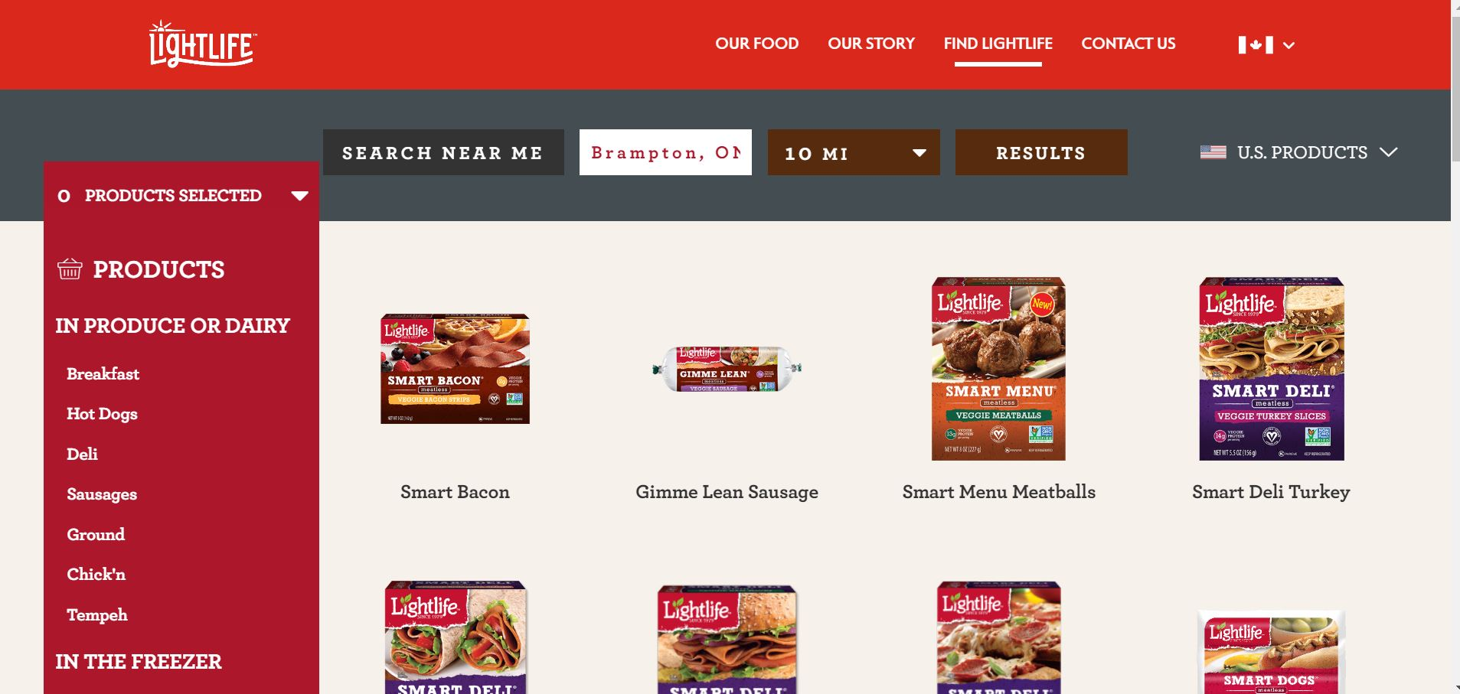
Inspiration
LightLife Website
Uses Destini Product Locators
This costs Lightlife thousands of dollars every year

Slide 5
DESIGN
Key principles that we used when designing our solution:
Quick search speed
Customers are waiting on the phone so they should not have to wait too long
Clean and simple interface
Low maintenance long-term

Slide 6
Our solution
Easy and accessible platform
Fast search, returns a result in desired time
Consists of valuable information such as nearest stores, details about product, pictures

Slide 7
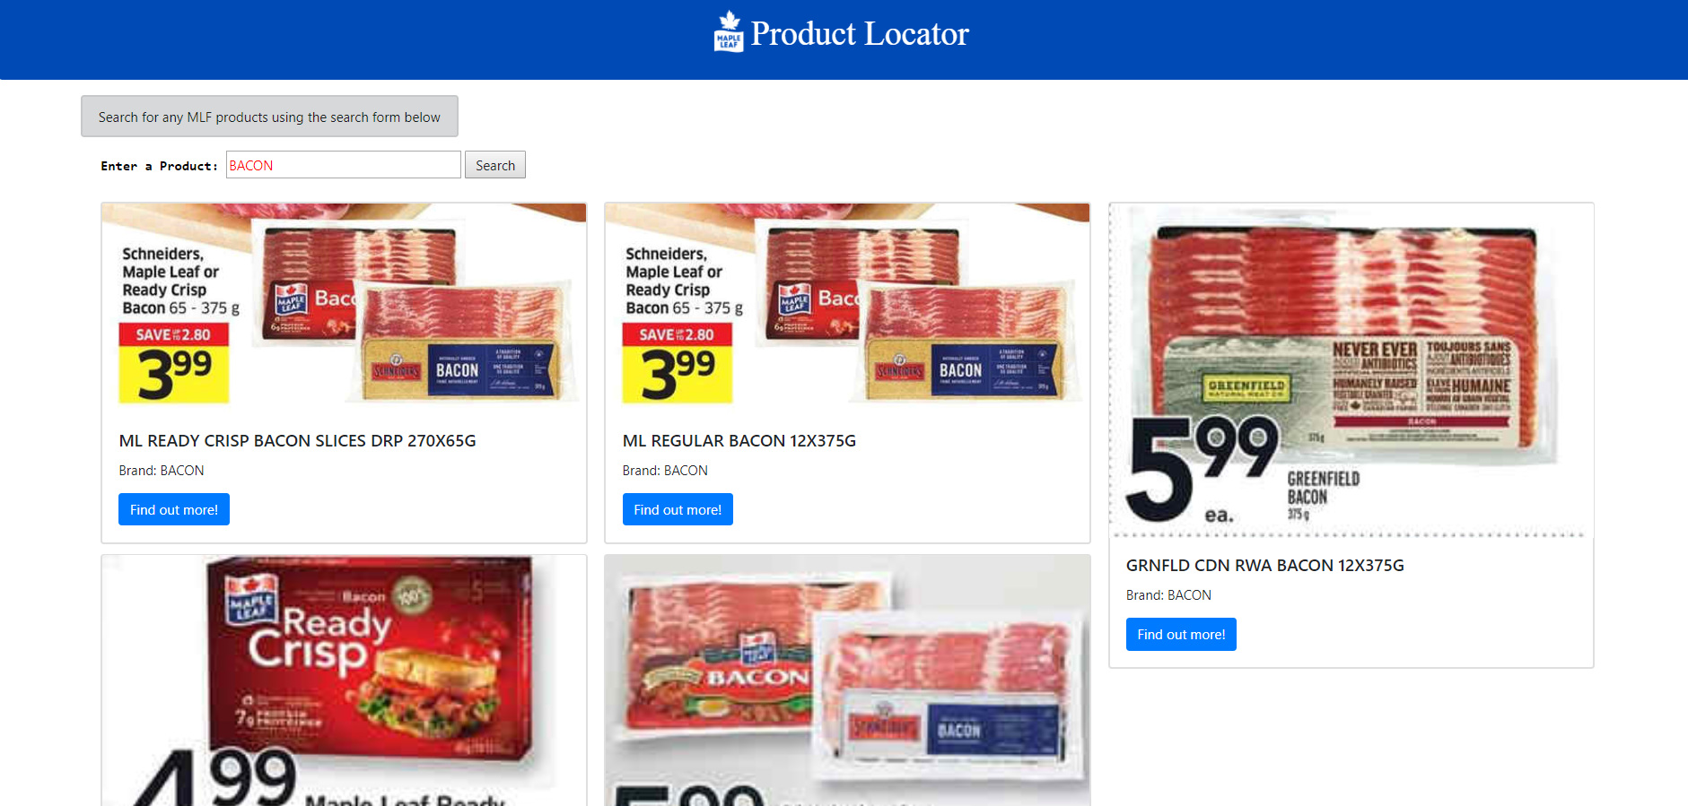
DEMO

Slide 8
Technology stack
Flask – Python Web framework
Pandas
HTML and CSS
Gensim (Word2Vec)

Slide 9
Things to know before using/updating
Pip install: pandas, flask, boot-strap
Understand the formatting of the data

